Slide 1
HUMAN DETECTION ROBOT
ECE4003 – EMBEDDED SYSTEM DESIGN
J-COMPONENT REVIEW-III
Fall 2020-2021
GROUP MEMBERS:
1. 18BLC1067 – ASHUTOSH PANDEY
2. 18BLC1068 – PATEL DEVARSHI
3. 18BLC1092 – SHAURYA GUPTA
4. 18BLC1113 – THAKUR SIDDHANT CHANDRAKANT
Presented to : Prof. V. Prakash, AP, SENSE, VIT Chennai

Slide 2
OBJECTIVE OF THE PROJECT
This project aims to give a practical design, to build a human detection robot which will be controlled by an operator in areas affected by natural calamities, like an earthquake or flood. Detection of human in appropriate time is very important in such situations and can be done using this robot.

Slide 3
EMBEDDED DESIGN PROCESS

Slide 4
Requirements
Purpose :
To move on the command of an user remotely in environments where humans may not go themselves.
To detect a human if present and alert the user.

Slide 5
Input:
Commands from the user to move forward, backward , left and right.
Output:
Move according to the command provided by the input.
Alert the user when a human is detected.

Slide 6
Functions:
The user operates a joystick remote control to operate the robot.
The robot should move with substantial speed in all directions that the user desires, that is, forward, backward, left , right.
While moving , if a human is detected, the robot should stop and alert the user in form of a led or flashlight on the remote or a buzzer on remote control.
The human should be notified of the help he/she is receiving through a buzzer on the robot.

Slide 7
Design Metrics
Power Dissipation : As required by the microcontroller , motor and RF transmitter and receiver.
Performance : There should be no delay between the user command and operation.
Range : Should operate well within the range of up to 100 meters.

Slide 8
Process Response time:
As the human is detected the buzzer should start at the same instance.
The user command and robot operation should have a large delay.

Slide 9
Specification
Dip switch type function for the remote controller which sends the command decided for the respective direction.
Transmission and receiver capability to receive the user command and operate.
Sensor to detect human response.
A buzzer connected to the robot to create sound to alert the human detected.
Rubber padded wheels for withstanding rough terrain operations.
Antenna to increase range of operation.
High Temperature withstanding choice.

Slide 10
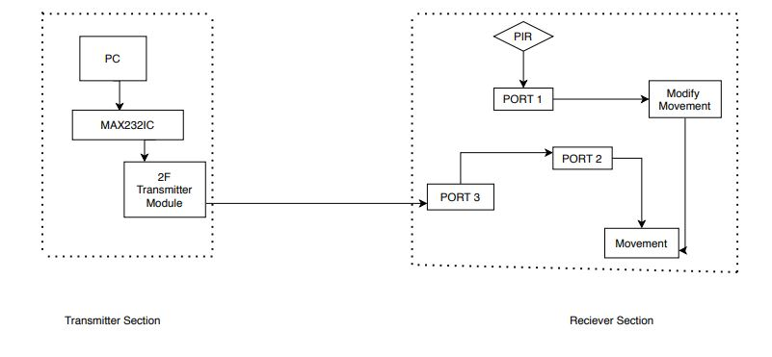
Block diagram(Overall system design)

Slide 11
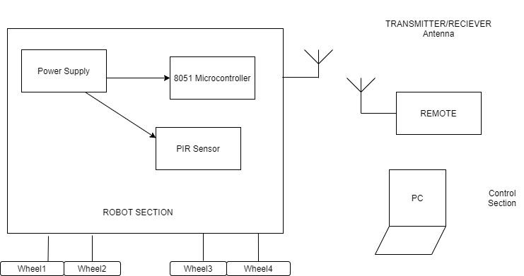
Block diagram(HARDWARE)

Slide 12
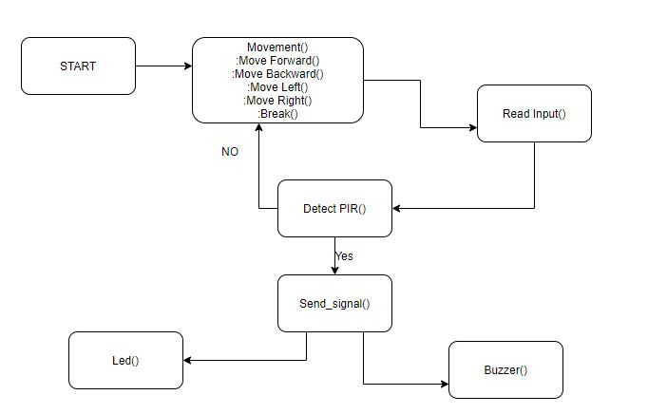
Block Diagram (Software diagram)

Slide 13
Components
Hardware components:
Transmitter section:
PC, RF Transmitter which will transmit user inputs to the robot .
MAX232 makes the input from the pc compatible with RF transmitter module.
DB9 Connector: Designed to work with social interference for keyboard, joystick etc.
Receiver section:
AT89C51 MICROCONTROLLER for processing the inout.
L293"D" motor drive IC
RF receiver module.
Motors for the bot mobility.
PIR sensor for human detection.

Slide 14
Software components:
Move forward(): to move the robot forward.
Move backward (): to move the robot backward.
Move left (): to move the robot left.
Move Right (): to move the robot right.
Break(): To stop the robot.
Detect PIR(): To monitor the PIR sensor and detect when it is high.
Read Input(): Read the user input from a virtual terminal.

Slide 15
Tools Required
(1.) PC, RF Transmitter and MAX232 for the tansmitter section.
(2.) DB9 Connector
(3.) L293 motor drive IC
(4.) RF reciever module
(5.) Motors for the bot mobilitiy.
(6.) PIR sensor for human detection.

Slide 16
System Integration
All user commands insert function correctly.
Each Task should be tested with test inputs.
Testing the operation at the upper limit range of operations.
Testing for a human detection accuracy in different environments.

Slide 17
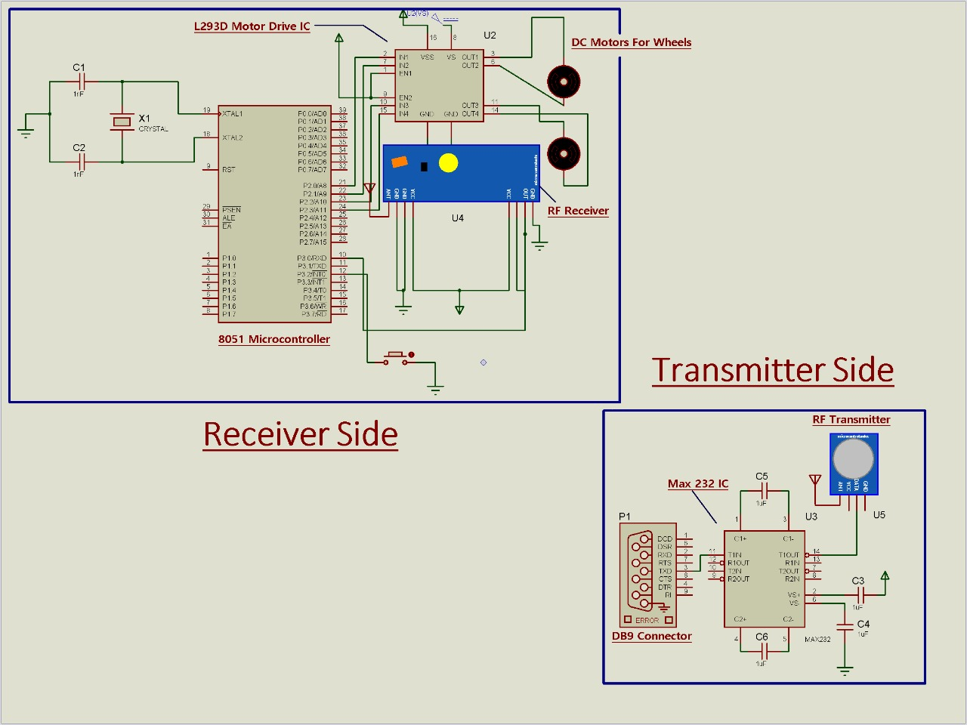
Schematic diagram

Slide 18
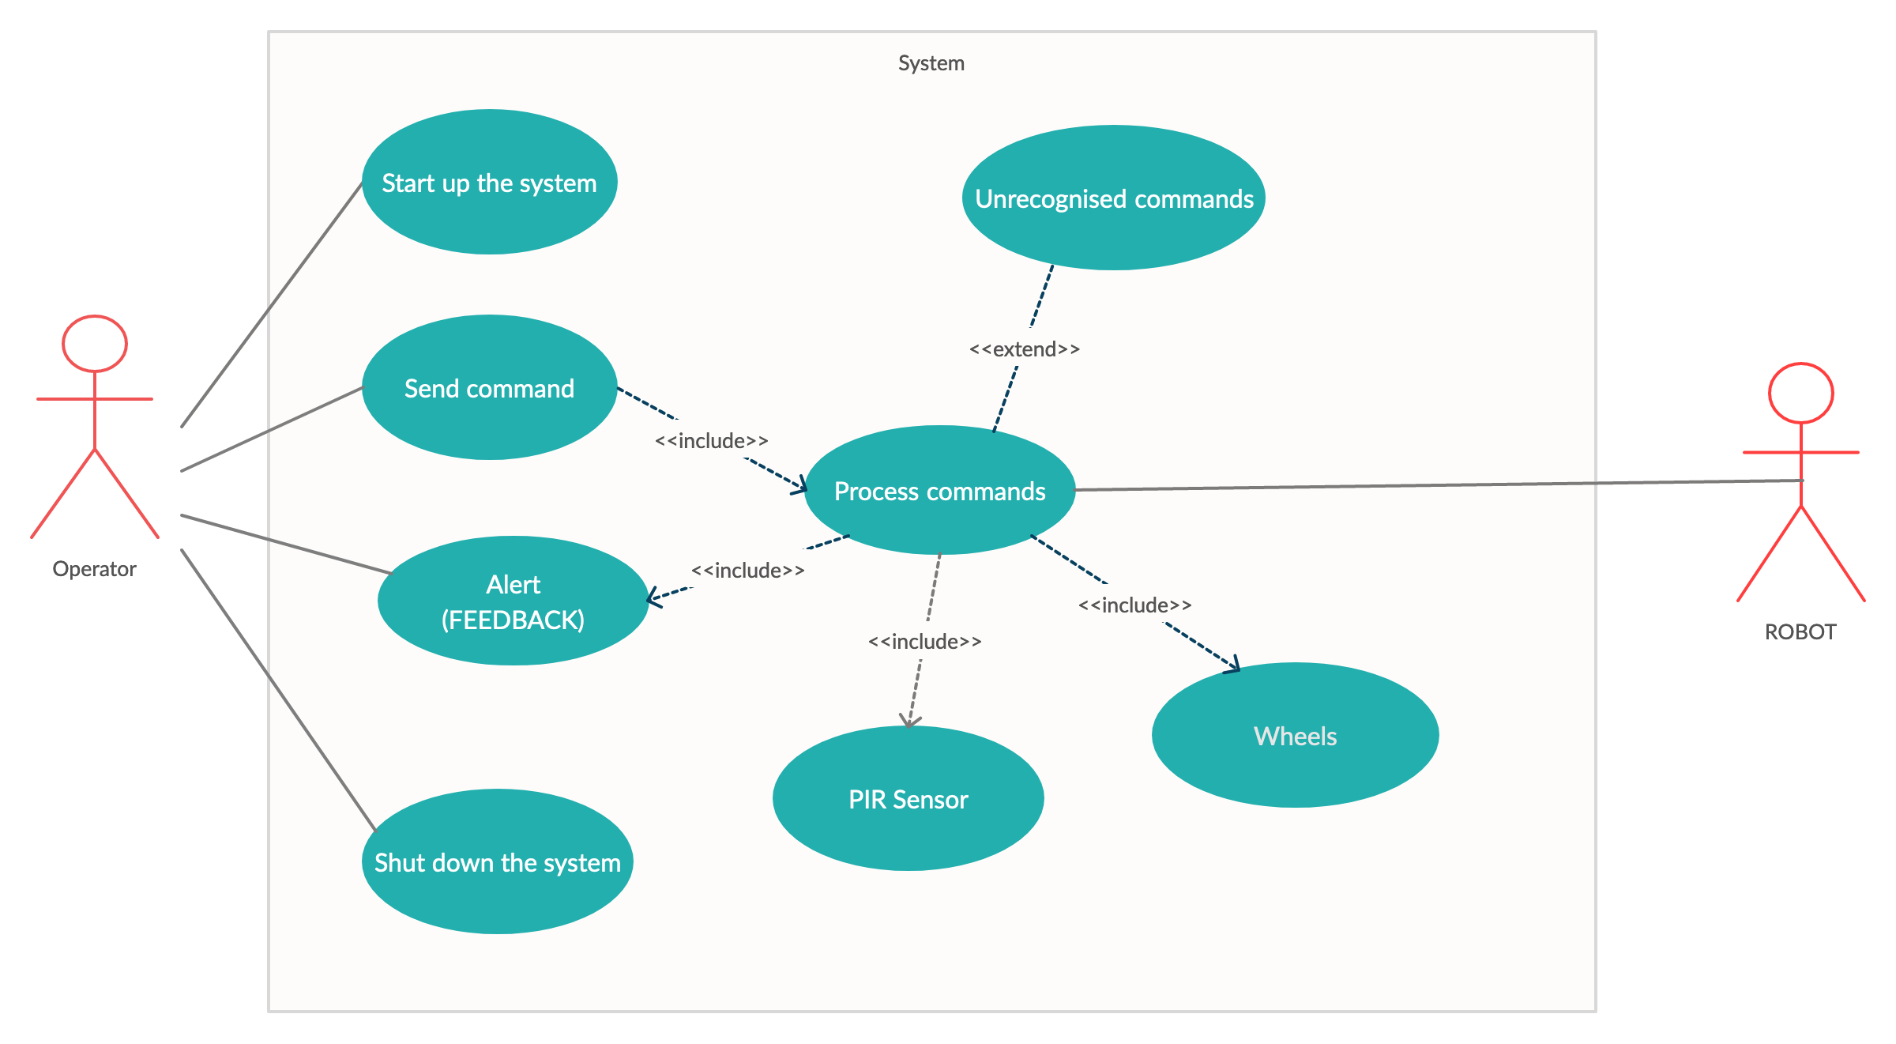
ALGORITHM
UML Use Case Diagram

Slide 19
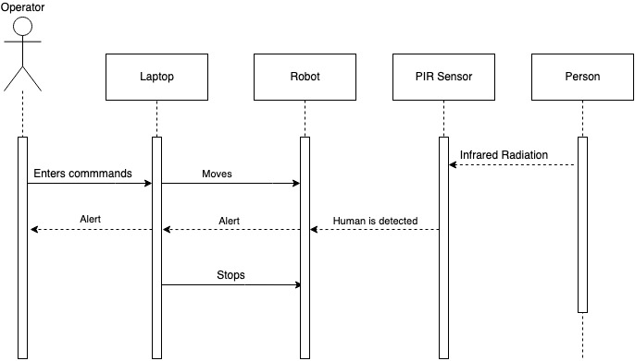
UML Sequence Diagram

Slide 20
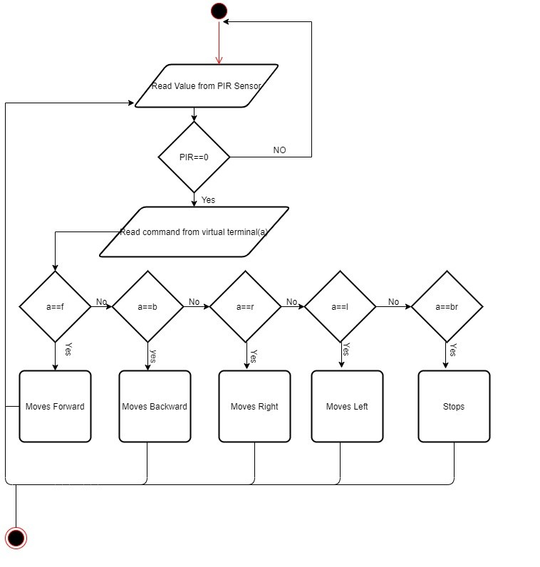
UML Activity Diagram

Slide 21
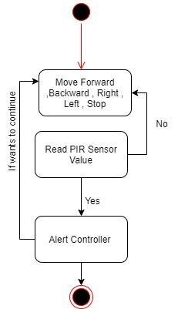
UML State Diagram

Slide 22
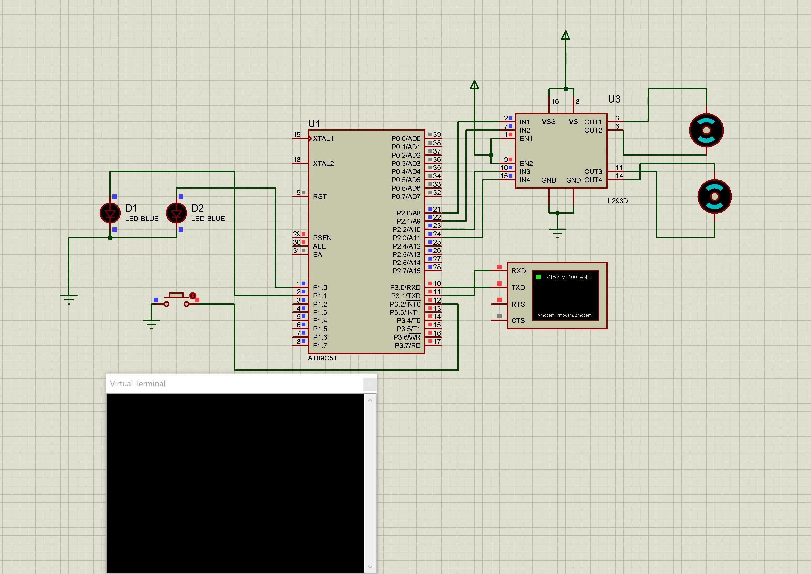
SOFTWARE IMPLEMENTATION

Slide 23
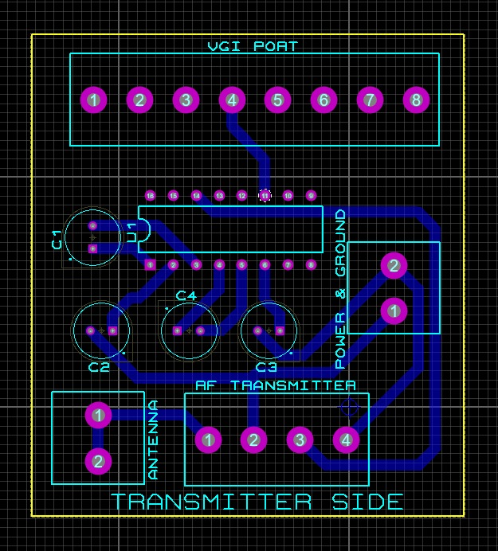
PCB DESIGN
Transmitter side

Slide 24
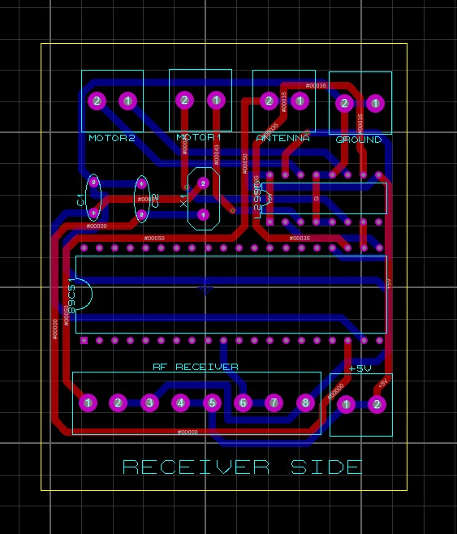
PCB DESIGN
Receiver side

Slide 25
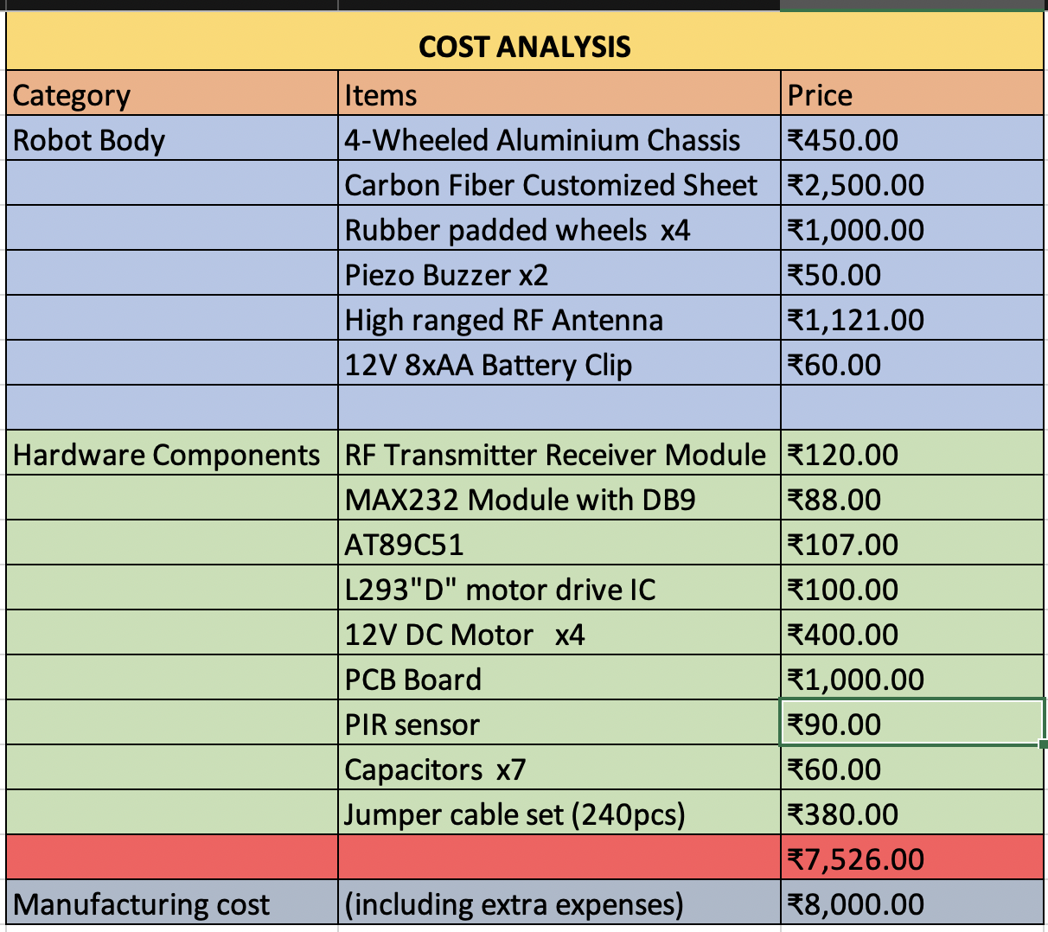
COST ANALYSIS

Slide 26
APPLICATIONS
The main application that we based our project on, was to detect humans under debris at locations where some sort of disaster might has taken place.
Home intrusion detection, an automated robot can be deployed which will do a complete surveillance of the house when the owner is not present. It would be cost efficient as the cost of multiple sensors would be reduced.
A wireless camera can be fitted on the robot and then can be deployed on the battlefield of a war to gain useful intelligence from the opposing side.
Human detection deployed with image processing can help in great effect in today’s pandemic-stricken world, as it can be used to detect whether a human is wearing a mask.
Human detection can also be employed into traffic cameras and drones, and with IOT based measures can be used to determine red corona zones.

Slide 27
Possible Upgrades
This Human Detection robot can be improved by using high range sensors (Laser, ultrasound or powerful thermal cameras), GPS, and motors of high capacity. Long distance telecommunication protocols can be also proposed in any future version of this robot.
Embedded smart cameras can be used as a possible upgrade for future work of the human detection robot .
An IoT-based robot with artificial intelligence may be utilized in various fields of surveillence. In the case of image context processing it is useful to apply convolutional neural network (CNN)-based machine learning (ML), which is introduced for the precise detection and recognition of images or patterns, and from which can be expected a high performance of recognition.

